Slide 1
大学英语 Lesson8 动词时态和语态
主讲人：周丽莉

Slide 2
目录
01.
时态
02.
语态

Slide 3
动词时态
第一章节
PART ONE

Slide 4
啥叫动词时态？
动词时态表示谓语动词的动作或状态发生的时间和方式（状态）。
时态 = 四种不同的时间 + 四种不同的方式
现在
过去
将来
过去将来
一般
进行
完成
完成进行
16种时态

Slide 5


时态一览表
 | 现在 | 过去 | 将来 | 过去将来
一般
进行
完成
完成进行
时 间
方式（状态）
ask/ asks
asked
shall/ will ask
should/ would
ask
am/ is/ are
asking
was/ were
asking
shall/ will be
asking
should/ would be
asking
have/ has asked
（过去分词）
had asked
shall/ will
have asked
should/ would
have asked
should/ would have been asking
have/ has been
asking
had been
asking
shall/ will have
been asking

Slide 6
时态一览表
 | 现在 | 过去 | 将来 | 过去将来
一般 | ask/ asks | asked | shall/ will ask | should/ would ask
进行 | am/ is/ are asking | was/ were asking | shall/ will be asking | should/ would be asking
完成 | have/ has asked | had asked | shall/ will have asked | should/ would have asked
完成进行 | have/ has been asking | had been asking | shall/ will have been asking | should/ would have been asking
时 间
方式（状态）

Slide 7
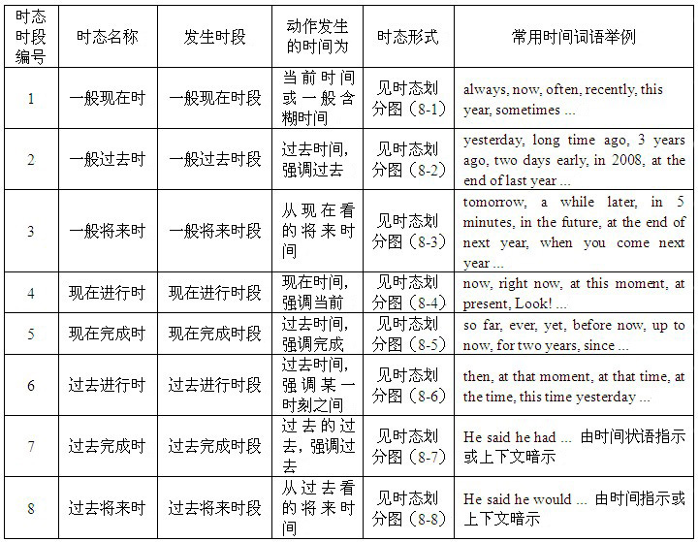

Slide 8
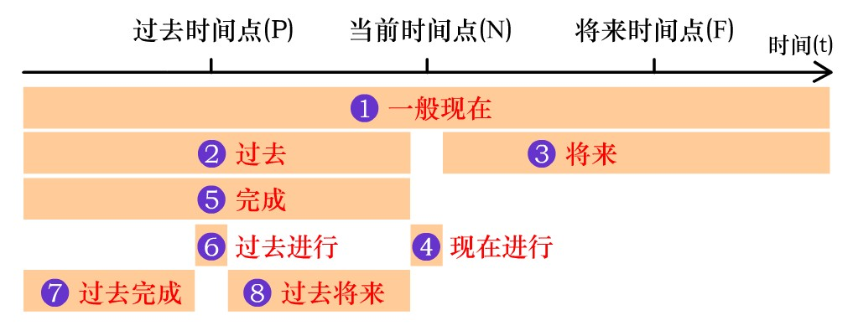
谓语动词常用八种时态的划分图

Slide 9
时 间
现 在
do/ does
am/ is/ are
Mike is very happy now.
麦克现在很开心。

Slide 10
时 间
现 在
将来
do/ does
am/ is/ are
will/ shall do
will/ shall be
We will learn English next term.
下学期我们将学英语。

Slide 11
时 间
过 去
现 在
将来
did
was/ were
do/ does
am/ is/ are
will/ shall do
will/ shall be
We learned English last term.
上学期我们学了英语。

Slide 12
时 间
过 去
过 去
过去将来时
现 在
将来
did
was/ were
did
was/ were
would/ should do
would/ should be
do/ does
am/ is/ are
will/ shall do
will/ shall be
过去将来时：是以过去时间点出发，站在过去的视角，看当时将会发生的动作或状态。
She said that she would come to see me.
她当时说她将会来看我。
（她“说话“这个动作是发生在过去，“她来看我”这个动作将发生在她说话这个动作之后，所以用过去将来时态。）

Slide 13
时 间
过 去
过 去
过去将来时
现 在
将来
did
was/ were
did
was/ were
would/ should do
would/ should be
do/ does
am/ is/ are
will/ shall do
will/ shall be
以上这四种时间强调的是时间点，即具体的时间。
英语中还有两种表达时间段的结构，即：进行时、完成时。

Slide 14
进行时态
表示现阶段正在重复进行的动作。
正在进行
现阶段
现 在

Slide 15
完成时态
已成事实——对过去已做之事进行回顾
已经做了
已经做过
时间助词
have
done
状态动词
有
有做过
“已经”和“有”的内在含义是一致的。

Slide 16
完成时态
到目前为止已经有做过的动作
以现在完成时为例
这一阶段完成的动作
过 去
现在
I have spent all of my money.
（到现在为止）我已经花光了所以的钱。

Slide 17
完成时态
到目前为止已经有做过的动作
以现在完成时为例
现在完成时
将来完成时
过 去
现在
将来
现在完成时：以现在的视角出发，动作发生在现在的过去，但是其动作造成的影响持续到现在。
同理，如果动作发生在现在，其造成的影响持续到将来的某一时间，
叫将来完成时。同理我们还可以推出过去将来完成时。

Slide 18
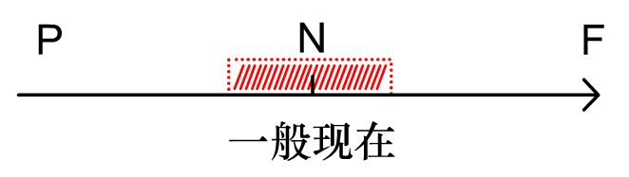
1. 一般现在时
形式：主语 + 动词原形
【若主语是第三人称单数，动词原形要有相应变化】

Slide 19
知识回顾：各类动词一般现在时的第三人称单数变化形式
am I am ...
is he/she/it is ...
are we/you/they are ...
动词be
一般现在时
bb
+s
write – writes
动词第三人称
单数变化
go – goes
wash – washes
watch – watches
fix – fixes
主语是第三人称单数时
+es
变y为i+es
study – studies
辅音字母+y结尾的词
特殊变化
have – has

Slide 20
一般现在时基本用法
1) 表示经常性或习惯性的动作或存在的状态。常与表示频度的时间状语连用：always, often, usually, sometimes, rarely, never, once a week, now and then(有时).....
She always takes a walk in the morning.
I talk with my parents by phone from time to time(有时).
It seldom in this part of the country.
A. have rained B. rained C. is raining D. rains
D

Slide 21
一般现在时基本用法
2) 表示现在发生的动作、情况、状态和特征(表示特征、能力或现实的情况或状态)。
Mike is very happy now.
The foreign man standing in the doorway speaks Chinese.
People enjoy reading books about the rich and the famous.
3) 表示格言、客观事实或普遍真理。
Time and tide wait for no man.
The sun is a star that gives out light and heat.
The sun rises in the east and sets in the west.
Christmas is one of the most important festivals in Western countries. It on December 25.
A. has fallen B. fell C. falls D. is falling
C

Slide 22
PS 高能预警
一般而言，如果一个句子里有宾语从句，宾从的时态应和
主句的时态保持一致，但当宾语从句是表示客观事实或规
律等的句子时，这宾从的时态可以不受主句时态的限制，
要用一般现在时。
请判断以下句子划线处时态对错：
The teacher told his students that light travels much faster than sound.
✔
教材P5

Slide 23
一般现在时基本用法
4) 表示安排或计划好的将要发生的动作，或表示按时间表将要发生的动作，这种安排不可更改或随意变动，句中常有一个表示将来的时间状语。常见的这类动词或短语有：be, arrive, come, go, start, begin, leave, return, end, stop....
The concert begins at 7:00 p.m. and ends at 9:30 p.m..
My train leaves at 8:30 tomorrow morning.
The plane in Brussels, a very beautiful city, at nine o’clock tonight.
A. arrives B. will arriving C. would arrive D. have arrived
A

Slide 24
一般现在时基本用法
5) 若一个句子中有时间、条件状语从句，主句如果用一般将来时，从句常用一般现在时表将来，即“主将从现”.
I'll call you as soon as I get to Beijing.
We will discuss the matter when we meet tomorrow.
You’ll surely succeed if you try your best.
The new manager will take over the plan as soon as she to the company.
A. will come B. comes C. is coming D. is going to come
主句
时间状语从句
B

Slide 25
一般现在时基本用法
6) 以 here 或 there 开头的句子，说明正在发生的动作，谓语动词不用现在进行时，而用一般现在时。
Get it ready. Here comes a bus.
Look ! There flies a kite in the sky.

Slide 26
练习1
D
Jason and Thomas __________ brothers. They study at the
same school.
A. be B. am C. is D. are
解题思路
主语是第三人称复数
Jason and Thomas
关键词study
对时态的判断

Slide 27
练习2
— Can your father drive?
— Yes, and he usually __________ me to school.
A. drove B. is driving C. drives D. has driven
C
解题思路
can
解题思路
关键词
判断为一般现在时
usually关键词

Slide 28

小结
概念：经常、反复发生的动作或行为及现在的某种状况。
时间状语：often, usually, always, sometimes, every week (day, year, month ...), once a week, on Sundays, etc.
基本结构：①be动词；②行为动词
否定形式：① am／is／are ＋not；②此时态的谓语动词若为行为动词，则在其前加don’t，如主语为第三人称单数，则用doesn’t，同时还原行为动词。
一般疑问句：①把be动词放于句首；②用助动词do提问，如主语为第三人称单数，则用does，同时，还原行为动词。

Slide 29
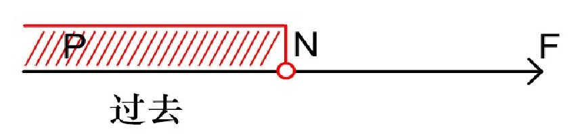
2. 一般过去时
形式：主语 + 动词过去式

Slide 30
知识回顾：动词过去式的变化形式
辅音字母加y，变y为i，加ed
以e结尾，直接加d
动词be的过去式变化
carry — carried
like — liked
am — was
is — was
are — were
行为动词的过去式
stop — stopped
work — worked
重读闭音节，双写辅音字母加ed
直接在词尾加ed
特殊的：have-had do-did等

Slide 31
一般过去时基本用法
1) 在确定的过去时间里所发生的动作或存在的状态。常与表示过去的时间状语连用，如：a moment ago, three days ago, last night, last Friday,yesterday, the day before yesterday...,有时没有表示过去的时间状语，需要根据上下文推断。
Where did you go yesterday?
Could you please repeat your words? I missed it.
Her English was very good at that time.
2) 表示过去经常性或习惯性的动作或存在的状态（P6）。
Did he often go swimming last summer?
When I was in the countryside, I often walked by the riverside.
3) 在时间和条件状语从句中，用一般过去时代替过去将来时。
He said he would call me as soon as he arrived in Shanghai.

Slide 32
练习1
D
— When __________ your mother __________ you that
blue dress, Mary?
— Sorry, I really can’t remember.
A. does; buy B. has; bought C. had; bought D. did; buy
判断为过去时态
连衣裙已经买过了
解题思路
看问句
不记得什么时候
Sorry, I really can’t remember.
看答句

Slide 33
练习2
— Nancy is not coming to the party tonight.
— But she _________ me she’d love to.
A. tells B. told C. had told D. is telling
B
因为从句是过去式，所以主句用相应的过去范畴时态
判断为一般过去时
解题思路
判断为宾语从句
’d是would的缩写
看答句
she’d love to.

Slide 34
小结
概念：过去某个时间里发生的动作或状态；过去习惯性、经常性的动作、行为。
时间状语：ago, yesterday, the day before yesterday, last week (year, night, month ...), in 1989, just now, at the age of 5, one day, long long ago, once upon a time, etc.
基本结构：①be动词；②行为动词
否定形式：① was／were＋not；②在行为动词前加didn’t，同时还原行为动词。
一般疑问句：①was或were放在句首；②用助动词do的过去式did提问，同时还原行为动词。

Slide 35
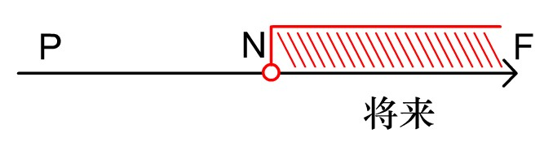
3. 一般将来时
形式：主语（第一人称） + shall + 动词原形
主语 （各个人称）+ will + 动词原形
主语+ am/is/are going to + 动词原形
主语+ am/is/are + 不定式（to do）
主语+ am/is/are about + 不定式
主语+ am/is/are + 现在分词（仅限位移动词）

Slide 36
主语+will/shall +not+动词原形+ ...
主语+will/shall +动词原形+...
否定句
肯定句
Will/Shall +主语+动词原形
一般将来时的构成
疑问词+一般疑问句？
一般疑问句
特殊疑问句

Slide 37
一般将来时基本用法
表示在将来某个时间要发生的动作或存在的状态，一般会与表示将来的时间状语连用。如：tomorrow, the day after tomorrow, next week/month/year, soon, some day...
We will go to see the film tomorrow.
具体用法如下：

Slide 38
一般将来时常见形式
1) 表示未来的动作或状态，常用will / shall + 动词，shall（第一人称），will（各人称）。时间状语有：tomorrow，next week 等等。
I'll go to your city tomorrow.
2) be doing（仅限位移动词），表计划的将来，但语气不及一般现在时肯定，安排可以变更，常用动词有：go, come, leave, arrive等。
He is leaving for America on business next month.
3) be going to do，表示将来。
a.主观的打算、意图，即将做某事。
What are you going to do tomorrow?
b. 表示“预测”，说明有迹象要发生的事 Look at the dark clouds, there is going to be a storm.

Slide 39
Tips:
be not about to do 意为“不愿做..., 不打算做...”
Sam is not about to do that thing.
萨姆不愿再做那件事。
4) be to do表将来，按计划或正式安排、约定、意图、职责、义务、命令或要求将发生的事，在if引导的条件从句中，表示一种愿望。
We are to discuss the report next Saturday.
You are to finish the work by Friday.
If you are to succeed, you must work hard.
5) be about to do，意为马上做某事，即将发生的动作。
He is about to leave for Beijing.
The new school year is about to begin.
注意：be about to 不能与tomorrow, next week 等表示明确将来时的时间状语连用。

Slide 40
一般将来时常见形式
6) 在“祈使句+and/or+陈述句”结构中，前面的祈使句部分表示条件，而and/or后面的句子应用一般将来时。（结合书上P147底部知识点）
Give me one more hour, and I'll finish the work.

Slide 41
PS 高能预警
be on the point of doing...也可表示即将发生某事，表示“正要做..., 即将做...”。
如：
She is on the point of crying.
她即将哭了。
教材P7

Slide 42
练习1
B
There __________ a talk show on CCTV-1 at nine this
evening.
A. will have B. is going to be
C. is having D. will be have
关键词
判断为
将来时态
this evening
解题思路
there is gong to be

Slide 43
练习2
— Please give this note to John.
— OK. I’ll give it to him as soon as he _________.
A. is coming back B. will come back
C. comes back D. come back
C
关键词
状语从句
comes back
as soon as
解题思路
主将，从现

Slide 44
小结
概念：表示将要发生的动作或存在的状态及打算、计划或准备做某事。
时间状语：tomorrow, next day (week, month, year ...), soon, in a few minutes, by ..., the day after tomorrow, etc.
基本结构：①am／is／are／going to ＋do；②will／shall＋do；③be doing（位移动词） ；④be to do；⑤be about to do
一般疑问句：①be放于句首；② will／shall提到句首

Slide 45
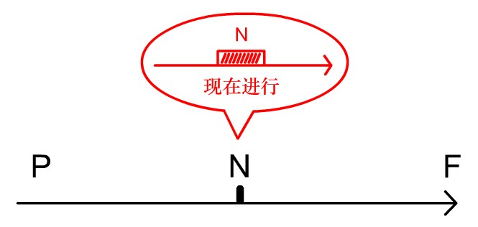
4. 现在进行时
形式：主语 + be + v.ing

Slide 46
主语+be (am, is, are)+not+现在分词+...
主语+be(am, is, are)+现在分词+...
否定句
肯定句
Be (Is/Are)+主语+现在分词
现在进行时的构成
疑问词+一般疑问句？
一般疑问句
特殊疑问句

Slide 47
现在进行时基本用法
表示现在、目前或现阶段正在进行的动作或发生的事情。常与这些时间状语连用：now，at this/ the moment, right now, these days, this week, today, nowadays, at present等。
What are you doing these days?
Lily is writing a list of books to read now.
Listen! She is singing a song.

Slide 48
现在进行时基本用法
与always, constantly( 总是，经常地，不断地), forever 等词连用，表示反复发生的动作或持续存在的状态，往往带有说话人的主观色彩,如赞许、厌烦、不满、同情等。
You are always changing your mind.（不满）
He is always making trouble for his friends.(不满)
The little boy is always thinking of others.(赞许)

Slide 49
现在进行时基本用法
注意：以下词语不能用于进行时态：
①表示感情状态的：love, adore(热爱), prefer, like, hate, detest(讨厌)等；
②表示感知感觉的：see, hear, taste, smell, appear, seem, sound, look等;
③表示理解、思考等心理活动：realize, know, remember, believe, forget, understand等；
④表示存在的状态：exist, stay, remain, obtain等；
⑤表示所属关系的：have（有）, contain, belong to, own, possess, consist of(由...组成；包括)等；
⑥表示行为结果的：accept, admit, allow, decide, promise, recieve等。

Slide 50
练习1
A
Don’t turn on the TV. Grandma __________ now.
A. is sleeping B. will sleep
C. slept D. sleeps
关键词
解题思路
判断为现在进行时
now

Slide 51
练习2
— Where is Mike? He asked me to go out for a walk this
evening.
— Maybe he __________ TV in the living room now.
A. watched B. will watch C. is watching D. watches
C
判断为现在进行时
解题思路
关键词、句
now
Where is Mike?

Slide 52
小结
概念：表示现阶段或说话时正在进行的动作及行为。
时间状语：now, at this time, these days, etc.
基本结构：am／is／are ＋doing
否定形式：am／is／are ＋not＋doing
一般疑问句：把be动词放在句首

Slide 53
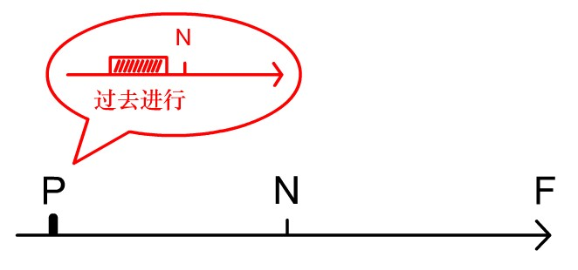
5. 过去进行时
形式：主语 + be(was/were) + ving

Slide 54
主语+ be(was/were) +现在分词+...
主语+ be (was/ were) +not+现在分词+...
否定句
肯定句
Was/were+主语+现在分词
过去进行时的构成
疑问词+一般疑问句？
一般疑问句
特殊疑问句

Slide 55
过去进行时基本用法
表示过去某个时刻或某个阶段正在进行的动作，常与这些时间状语连用：at that time, this time yesterday, the whole morning，all day yesterday等。
He was preparing his lecture all day yesterday.
We were talking about the new book the whole morning.
与when或while引导的表示过去的时间状语从句连用，主句可用过去进行时。
I was watching a football match when you called me.
They were still working when I left.

Slide 56
练习1
— Did you see a girl in while passed by just now?
— No, sir. I __________ a newspaper.
A. Read B. was reading C. would read D. am reading
B
根据题意应是刚才正在做什么
解题思路
判定为过去范畴的时态，排除A、D
关键词just now

Slide 57
练习2
— Were you at home at 9 o’clock last night?
— Yes, I __________ a shower at that time.
A. Took B. was taking C. was taken D. am taking
B
可以判定用过去进行时
解题思路
at 9 o’clock last night
at that time
关键词

Slide 58
小结
概念：表示过去某段时间或某一时刻正在发生或进行的行为或动作。
时间状语：at this time yesterday，at that time或以when引导的谓语动词是一般过去时的时间状语从句等。
基本结构：was／were ＋doing
否定形式：was／were ＋not＋doing
一般疑问句：把was或were放在句首

Slide 59
6. 将来进行时
P
N
F
形式：主语+ Shall/will + be(am/is/are) + ving

Slide 60
将来进行时基本用法
表示在将来某一时刻、某段时间内或某个动作发生时正在进行的动作，或按计划在将来某时候、某段时间内或某个动作发生时将要进行的动作。常与这些时间状语连用：this time tomorrow, next week, next month, at 8 tomorrow....等。
This time tomorrow we shall/ will be working in that factory.
This time next week we shall/will be lying on the beach of Sanya.
I think Tom and his parents the famous palace this time tomorrow.
A. visit B. are to visit C. will be visiting D.will visit.
c

Slide 61
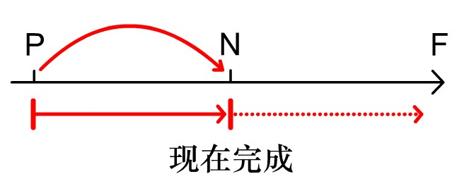
7. 现在完成时
形式：主语+ have/ has + 过去分词

Slide 62
主语+have/has +not+过去分词+...
主语+have/has+过去分词+...
否定句
肯定句
Have/Has+主语+过去分词
现在完成时的构成
疑问词+一般疑问句？
一般疑问句
特殊疑问句

Slide 63
现在完成时基本用法
1. 表示已经做完某事，强调过去所发生的动作或事情对现在的影响或产生的结果，着眼点在现在。常与不确定的时间状语连用：yet(到目前为止), already, just, before, recently, lately（近来）...等。
I have already finished my homework.
We have just come back from the United States.
2. 过去经历过的事情。常与表示频度的时间状语连用，如：often, ever, never, only, once, twice等。
I have never heard Bonnie speak ill of you.
I have only been to the Great Wall once.
have/has been to 与 have/has gone to
have/has been to “去了并且回来了”，常与once, twice, never, ever等连用；
have/has gone to “去了还没回来”
(P9)

Slide 64
since引导的时间状语从句常用一般过去时，主句常用现在完成时。
(P9)
现在完成时基本用法
3. 表示从过去开始，持续到现在的动作或状态，而且还有可能延续下去。往往和“for ...”，“since ...””ever since(自那以后)” ”for a long time” “up to now”等表示一段时间状语连用。
He has learnt English for six years.
She has studied playing piano since 2006.
The Greens have lived in Beijing since they came to China.

Slide 65
PS 高能预警
It is/has been+一段时间+since从句，表示“自从....有（多久）”
此句型since引导的从句不能用否定形式，且时态应用一般过去时。
从句中的V若为短暂性v，表示动作已开始多长时间了；
从句中的V若为延续性v，表示动作已结束多长时间了。
如：
It has been three years since they got married.
It is five years since he was in the army.
自从他们结婚已经有三年了。
自从他离开陆军有五年了。
教材P9

Slide 66
PS 高能预警
This/That/It is the+序数词+time+that从句，表示“这/那是....第几次”
此句型从句应用现在完成时。
That is the first time the painting has been displayed to the public.
This/That/It is the best/worst/most/only+adj.+n.+that从句
此句型从句应用现在完成时。
This is the easiest job that I’ve ever done.
教材P10

Slide 67
PS 高能预警
含有瞬间意义的动词如join , die,leave,receive, buy, arrive等，不能与表示一段时间的状语连用，
例如：
He has joined the Army for 5 years (×)
He has been in the Army for 5 years. (√)
It is / has been 5 years since he joined the Army.(√)
I have received his letter for a month. （×）
I haven't received his letter for almost a month.（ √ ） 注意：非延续性动词的否定形式可以与表示延续时间的状语连用。即动作不发生的状态是可以持续的。

Slide 68
1
— Hello! Can I speak to Alice?
— Sorry. She isn’t here right now. She __________ to
the shop.
A. goes B. will go C. has gone D. was going
C
当事人不在，用have/has gone
解题思路
关键词
She isn’t here right now.

Slide 69
2
A
Mr. Brown and his family have __________ New York
for a few weeks.
A. been in B. worked C. gone to D. left for
for a few weeks
解题思路
关键词
been in与表示一段时间的状语连用

Slide 70
3
C
— He _______ the English-Chinese dictionary for about
twenty years, but it is still new.
— What a careful man!
A. has bought B. has borrowed
C. has had D. borrowed
for about twenty years
解题思路
关键词
buy，borrow为短暂性动词，不能与表示一段时间的时间状语连用，排除答案A、B、D

Slide 71
小结
概念：过去发生或已经完成的动作对现在造成的影响或结果，或从过去已经开始，持续到现在的动作或状态。
时间状语：recently, lately, since..., for..., in the past few years, etc.
基本结构：have／has ＋done
否定形式：have／has ＋not＋done
一般疑问句：have／has放于句首

Slide 72
▲比较过去时与现在完成时
1）过去时表示过去某时发生的动作或单纯叙述过去的事情，强调过去的动作；
现在完成时为过去发生的，强调过去的事情对现在的影响，强调的是影响。
I saw this film yesterday. （强调看的动作发生过了。） I have seen this film. （强调对现在的影响，电影的内容已经知道了。）

Slide 73
▲比较过去时与现在完成时
2）过去时常与具体的时间状语连用，而现在完成时通常与模糊的时间状语连用，或无时间状语。
一般过去时的时间状语: yesterday, last week，…ago, in 1980, in October, just now, 具体的时间状语
现在完成时的时间状语： for+一段时间, since+具体时间, so far, ever, never, just, yet, till / until, up to now, in past years, always, 不确定的时间状语

Slide 74
They have worked together for ten years
(可能仍在合作，也可能刚刚结束合作）
They worked together for ten years.
(过去曾一起合作，但现在已不在一起工作）

Slide 75
8.现在完成进行时
主语+have/has+现在分词：
表示从过去的某一时刻开始，一直延续到现在的动作，这个动作可能刚刚开始，也可能还要继续进行下去。强调延续过程，还可表示重复性的动作。如：
He has been working at the school for 30 years.
他一直在这个学校工作了三十年。
You have been saying you can succeed for five years.
五年来你一直在说自己能成功。

Slide 76
8.现在完成进行时
主语+have/has+现在分词：
注意(P12)：现在完成进行时中多用延续性动词。如：live, learn, stay, lie, sit, wait, sand, ....且常和all this time，this week， this month， all the morning， recently等时间状语，及for引出的短语，since引出的短语或从句连用。

Slide 77
现在完成时和现在完成进行时的区别：
下面就现在完成进行时和现在完成时作比较：
1）现在完成进行时和现在完成时都可表示动作对现在产生的结果，但前者所表示的的结果是直接的，而后者所表示的则是最后的结果。
比如：
Students have been cleaning the classroom.
Students have cleaned the classroom.
第一句可以译成“学生一直在打扫教室”。其直接结果可能是：学生还在忙于打扫教室。
第二句可以译成“学生把教室打扫过了”。其最后结果是：现在教室很清洁。

Slide 78
现在完成时和现在完成进行时的区别：
下面就现在完成进行时和现在完成时作比较：
2）现在完成进行时通常有延续性，现在完成时则没有。
比如：
They have been widening theroad.
They have widened the road.
第一句的意思是他们在加宽马路，尚末完工。
第二句的意思是已经完工，可以通车了。

Slide 79
现在完成时和现在完成进行时的区别：
下面就现在完成进行时和现在完成时作比较：
3） 现在完成进行时表示动作在重复，现在完成时则常常不带重复性。
比如：
Have you been meeting her lately?
Have you met her lately?
第一句有“经常相见”之意。
第二句则强调是否最近见过面。

Slide 80
现在完成时和现在完成进行时的区别：
下面就现在完成进行时和现在完成时作比较：
4） 现在完成进行时比较生动，含有明的感情色彩；而现在完成时往往只说明一个事实、一种影响或者结果，平铺直叙，没有感情色彩。比如：
Who's been eating my cookies?
Who's eaten my cookies?
第一句表示愤怒不满。现在完成进行时兼有进行时态，所以含有饼干“末”被全部吃光的意思。
第二句是完成时态，说明饼干“已经”被吃光了。

Slide 81
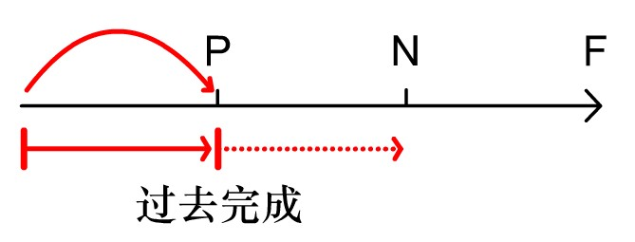
9. 过去完成时
形式：主语+ had + 过去分词

Slide 82
主语 + had + not +过去分词+...
主语+ had +过去分词+...
否定句
肯定句
Had+主语+过去分词
过去完成时的构成
疑问词+一般疑问句？
一般疑问句
特殊疑问句

Slide 83
过去完成时基本用法
构成: had +过去分词
1) 表示动作或状态发生在过去某一时刻或动作之前，即“过去的过去”。在过去不同时间发生的两个动作中，发生在先，用过去完成时；发生在后，用一般过去时。
When the police arrived, the thieves had run away.
The train had left before I got to the station.
2)表示意向、打算、希望、认为等的动词，如hope, wish, expect, think, intend, mean, suppose等，用过去完成时表示"原本…，未能…“
We had hoped that you would come, but you didn't.
当警察到的时候，小偷已经逃跑了。
我到达车站的时候，火车已经开走了。
我们本来希望你能来的，但你没来。

Slide 84
3) 过去完成时的时间状语before, by the end of, by the time , until , when。
He said that he had learned some English before.
By the time he was twelve, Edison had began to make a living by himself.
爱迪生十二岁的时候已经自食其力了。

Slide 85
PS 高能预警
no sooner… than; hardly ...when; scarely...when.. 刚… 就…
此句型时间状语从句用一般过去时，主句用过去完成时。
当no sooner，hardly或scarely谓语句首时，主句应部分倒装，即将助动词had放在主语之前。
如：
They had no sooner reached the office than it began to rain.
=
No sooner had they reached the office than it began to rain.
教材P11

Slide 86
1
C
By the end of last year, we __________ more than
2,000 words.
A. learnt B. have learnt
C. had learnt D. learn
By the end of last year
解题思路
关键词
判断用过去完成时态

Slide 87
小结
概念：以过去某一时间为标准，在此以前发生的动作或行为，或在过去某动作之前完成的行为，即“过去的过去”。
时间状语：before, by the end of last year (term, month ...), etc.
基本结构：had ＋done
否定形式：had ＋not＋done
一般疑问句：had放于句首

Slide 88
10. 将来完成时
形式：主语+ shall/will have + 过去分词
1. 表示在将来某时之前或某动作发生之前已经完成的动作。
I shall/ will have finished the job by next Friday.
They will have finished the project before next May.
I shall/ will have moved into the new house by the end of this week.
一般来说，如果句子出现了“by + 将来时间”构成的时间状语，句子就要用将来完成时。

Slide 89
10. 将来完成时
形式：主语+ shall/will have + 过去分词
2. 表示一个持续到将来某时之前或某动作发生之前的动作。
By next Monday, she will have studied here for three years.
By the time Mike retires from the army, his two sons in the college.
A. study B. have studied C. had studied D. will have studied
D

Slide 90
注意（P12）：by the time”到.....时为止”，可用作连词引导时间状语从句。
如果从句用一般过去时，主句用过去完成时，表示“过去的过去”
By the time he returned home, the meal had been served on the table.
到他回到家的时候，饭已经端到桌子上了。
如果从句用一般现在时（表示将来），主句用将来完成时
By the time you get back, I will have finished the housework.
到你回来的时候，我将已经做完家务了。

Slide 91
11. 过去完成进行时
形式：主语+ had been + 现在分词
表示过去某个时间或某个动作发生之前一直在进行的动作或存在的状态；还可表示在过去某段时间内反复发生的动作。
I didn’t know you had been suffering such great pain.
我（当时）不知道你一直在遭受着如此巨大的痛苦。
She had been telling me that I was not competent in the job.
她一直在告诉我，我不能胜任这项工作。

Slide 92
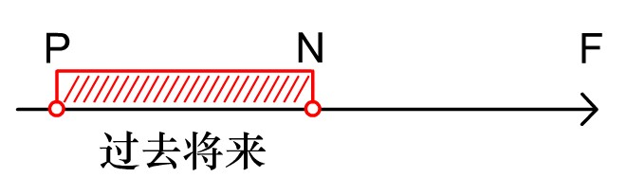
12. 过去将来时：
形式：主语+ should/would + 动词原形
表示在过去某时看来将要发生的动作或存在的状态。表示过去习惯性的动作或者存在的状态。用于间接引语及宾语从句中。
Every day, Mrs. Wang would go and talk with her students.
I didn’t know if she would come.
She said her mother would come to see her the next day.

Slide 93
例题1
D
I wondered ____________________.
when will the meeting end
B. when the meeting will end
C. when would the meeting end
D. when the meeting would end
I wondered
解题思路
关键词
判定从句用过去范畴的时态
I wondered
宾语从句
从句用陈述句语序
排除答案A、C

Slide 94
小结
概念：立足于过去某一时刻，从过去看将来，常用于宾语从句中。
时间状语：the next day (morning, year ...), the following month (week ...), etc.
基本结构：①was／were／going to ＋do；② would／should ＋do
否定形式：①was／were／not＋going to ＋do；②would／should ＋not＋do
一般疑问句：①was或were放于句首；②would／should提到句首

Slide 95
练习：
Months ago we sailed ten thousand miles across this open sea, which ___ the Pacific, and we met no storms.
A．was called B．is called
C．had been called D．has been called
2. I _____ ping-pong quite well, but I haven’t had time to play since the new year.
A. will playB. have played C. played D. play
B
说明：本题的干扰源为上下文的过去时，但“被称为太平洋”是客观现状，只能用一般现在时。
D
说明：常识告诉我们，一个人一旦获得某种技能，一般是不会在短期内失去的，所以需用一般现在时。

Slide 96
3. Since I won the big prize, my telephone hasn't stopped ringing. People _____ to ask how I am going to spend the money.
A. phone B. will phone
C. were phoning D. are phoning
4. Selecting a mobile phone for personal use is no easy task because technology _____ so rapidly.
A. is changing B. has changed
C. will have changed D. will change
D
说明：自从我赢了大奖，人们不停地打电话来问我将怎样使用这笔钱。此处的 are phoning 表示“不停的打电话”。
A
说明：选择移动电话难的原因是由于科技正在飞速发展，所以要用现在进行时；况且进行时态常给人一种情感上的描述，表示说话者的一种“感慨、赞赏、愤怒、斥责”等。

Slide 97
5. _____ my sister three times today but her line was always busy.
A. I’d phoned B. I’ve been phoning
C. I’ve phoned D. I was phoning
6. --- You haven’t been to Beijing, have you?
--- _____. How I wish to go there!
A. Yes, I have B. Yes, I haven’t
C. No, I have D. No, I haven’t
C
说明：此题的干扰源是后面的 was busy。今天打了三次电话是用来表示结果的，只能用现在完成时；而每次她都占线是表示过去的动作，所以用一般过去时。
D
说明：从补充的句子 “How I wish to go there!”可知“我”没到过北京。

Slide 98
7. --- Hi, Tracy, you look tired.
--- I am tired. I _____ the living room all day.
A. painted B. had painted
C. have been painting D. have painted
8. Now that she is out of a job, Lucy______ going back to school, but she hasn’t decided yet.
A had considered B has been considering
C considered D is going to consider
C
说明：这句话的意思是“我一整天都在刷起居室”，现在完成进行时表示从过去开始的一个动作一直持续到现在，而且还在进行当中。强调的是“一直在做”。
B
说明：她“一直在考虑返校”是现在完成进行时，“还没作决定”是现在的结果。

Slide 99
9. --- Nancy is not coming tonight.
--- But she _____!
A. promises B. promised C. will promise D. had promised
10. My uncle _____ until he was forty-five.
A. married B. didn’t marry
C. was not marrying D. would marry
B
说明：Nancy 答应要来这个动作应该发生在过去，是过去作出的承诺。
B
说明：until 用在肯定句中时，主句的动词必须是延续性动词，表示该动作一直持续到 until 后的时间为止；短暂性动词只能用在否定句中，表示直到此时该动作才开始。本题中 marry 是短暂性动词，所以只能用在否定句中，才能表示延续性意义。

Slide 100
动词语态
第二章
PART ONE

Slide 101
动词语态
主动语态
表示主语是动作的执行者。
如：She takes care of the little boy.
动词的语态
表示主语是动作的承受着。
如：The cup was broken by the boy.
被动语态

Slide 102
1、被动语态的用法
当不知道或没有必要指出动作的执行者时。
Printing was introduced into Europe from China.
当强调或突出动作的承受着时。
Many houses were destroyed in the war.
注意：有些习惯用法，如 be born，只以被动语态的形式出现。

Slide 103
1、被动语态的用法
不能使用被动语态的情况：
不及物动词不能用被动语态，如appear，die，happen，lie（躺，位于），remain，occur，come，true，break out，take place等。
表示“静态”的动词不能用被动语态，含连系动词，如last, benefit, dislike, join, mean, look like, consist of, have, possess, belong to, feel like, lack, cost, equal, become, suffer等。
This sort of things doesn’t happen in real life.
Each game lasts about an hour.
A healthy diet should consist of wholefoods.

Slide 104
现场试炼：
happened
A traffic accident ________(happen) just now.
sounds
Peking Opera ________ (sound) beautiful.

Slide 105
2、被动语态的形式
基本构成：
be + 及物动词的过去分词（+ by + 动作的执行者）
如：The cup was broken by the boy.
注意：不是过去时

Slide 106
2、被动语态的形式
be + 及物动词的过去分词（+ by + 动作的执行者）
被动语态也有时态、人称、数的变化，主要体现在be动词上。
常用被动语态 | 构成 | 常用被动语态 | 构成
一般现在时 |  | 现在完成时
一般过去时 |  | 过去完成时
一般将来时 |  | 将来完成时
现在进行时 |  | 过去将来完成时
过去进行时 |  | 过去将来时
am/is/are asked
have/has been asked
was/were asked
had been asked
will/shall be asked
shall/will have been asked
am/is/are going to be asked
should/would have been
asked
am/is/are being asked
was/were being asked
should/would be asked

Slide 107
1.Bananas are grown in Hainan.(海南种植香蕉。）
2.Many more trees will be planted in our school next year.（我们学校明年将种更多的树。）
3.Were the trees planted by him？这些树是他种的吗？
4.Young trees must be looked after.(必须照看好小树）
5. The building is being built. (那栋楼房正在建设中。）
6.The homework has been finished yet.（家庭作业已经做完了。）

Slide 108
3、语态转换
1.He teaches English in our school.
English is taught in our school by him.
宾提前变主，主变介by宾，被动be加done,时态看主动

Slide 109
2.We planted many trees last years.
Many trees were planted by us last year.
过去时的被动语态：
was/were+P.P

Slide 110
3.We should plant many more trees.
Many more trees should be planted by us.
含情态动词的被动语态：
情态动词+be +PP

Slide 111
4.She will teach Class 6.
Class 6 will be taught by her.
将来时的被动语态：
Will/shall+be +PP

Slide 112
5. Many countries have sent up satellites
into space.
Satellites have been sent up into space
by many countries .
完成时的被动语:
Have/has+been +PP

Slide 113
6.She is teaching Class 6.
Class 6 is being taught by her.
现在进行时的被动语态：is+being+pp

Slide 114
7.She gave me a book.
I was given a book by her.
A book was given to me by her.
如 遇双宾语，最好变间宾，如若变直宾，间宾前to/for（pass,lend,buy,write,bring, show,tell…）

Slide 115
8.He made me do the work.
I was made to do the work by him.
这些动词真奇怪，主动句中to 离开，被动句中to回 来。（feel,listen to,hear,let have,make,look at,see,watch…)

Slide 116
9.They take good care of the baby.
The baby is taken good care of by them.
注意：含动词词组的被动语态，须将其看作一个
整体，不可把它们分隔开来。

Slide 117
People say she knows five languages.
﹛
She is said to know five languages.
It is said that she knows five languages.
We believe the book has been translated into English.
﹛
The book is believed to have been translated into English.
It is believed that the book has been translated into English.
带宾语从句的句子改为被动语态时，有两种情况：
1）宾语从句的主语+be +主句谓语的过去分词+宾语从句谓语的不定式
2）It +be +主句谓语的过去分词+that+原宾语从句

Slide 118
3、主动表示被动的情况
1. 当此动词表示主语的品质或特性或事物的自然属性的时候:wash, write, sell, read, open, cut, lock, shut, close 等，常与well, easily, smoothly等副词连用，主语通常是“物”。此时，主动表被动
This type of recorder sells well.
That kind of shirt washes very well
The novel reads well.
The door opens with difficulty.
This kind of shirt cleans easily
Her coat caught in the door/ on the nail
The door won’t shut.
The library doesn’t open.

Slide 119
现场试炼：
The products of the brand well, because they have good quality and reasonable prices.
A.were selling B. had been sold C.were sold D. sell
D

Slide 120
want, need, require, deserve和be worth等词的后面可以用动名词的主动形式表示被动意义。
The book is worth reading .
The coat requires mending / to be mended.
The children needs looking after / to be looked after.
The table wants cleaning / to be cleaned.
The thief deserves punishing / to be punished.

Slide 121
某些作表语(expensive, cheap, difficult, fit, hard, light, heavy, easy 等)
形容词后，用不定式形式表示被动意义。
The box is too heavy to lift.
The fish is not fit to eat.
He is hard to please.
The passage is difficult to read.
The jewel is too expensive to buy.

Slide 122
练习：
A
Look. Mary _____ a nice dog.
She _____ it just now.
has drawn, drew B. drew, has drawn
C. is drawing, drew D. is drawing, has drawn
【解析】在“Look”、“It’s evening”、“Where is sb. …?”
等句子后面，可能要用““现在进行时”，也有可能要用“现在完成时”。要根据具体情况来具体分析，考虑问题一定要从整体情况着眼。本题后半句“just now”意为“刚才”，很明显要用“一般过去时”，因此前句如用“现在进行时”就不妥，造成句意逻辑上的错误。前句用“现在完成时”才对。所以本题答案应为“A”。

Slide 123
B
2. This kind of fridge _____ very well.
A. sell B. sells
C. are sold D. is sold
【解析】在英语中，表达某物销路不错，要用表示“特点”
的“一般现在时”的主动形式，而不能用“被卖”这种被动
语态形式来表示。由于本句主语“this kind of fridge”是单数
第三人称，所以本题答案应该选“B”。

Slide 124
D
3. What _____ Mr. Smith? He looks worried
so much.
A. happens with B. happens to
C. happened with D. happened to
【解析】在英语中，“发生”通常可译为“happened”或“took place”，要注意它不能变“被动语态”。本题之意是“史密斯先生出了什么事？他显得很焦虑。”因此，由题意看，这里表示事情已经发生过了，应该用“一般过去时”的“happened to sb”固定词组来表达，所以本题答案应该选“D”。

Slide 125
D
4. The book _____ by me. I _____ it to a friend
of mine already .
A. is written, sent B. is written, have sent
C. was written, sent D. was written, have sent
【解析】“书是被某人写的”、“书是在某地方被写的”都是表示发生在以前的动作，该用一般过去时被动语态。如果说“书是用英语写的”，那就是指书的特点了，就该用一般现在时被动语态了，排除A、B。由第二句话中的“already”可知，用完成时符合题意，所以本题答案应该选“D”。

Slide 126
C
5. Mr. Jackson _____ the city quite well since
he _____ in the city for a couple of years.
A. knows, was B. has known, was
C. knows, has been D. has known, has been
【解析】本句中的“since”不是“自从”之意，因此，前半
句与后半句用“现在完成时”和“一般现在时”的形式是错误的。本句中的“since”意为“由于”，与“as”近义。根据句意，“熟悉城市”是表示杰克逊先生的“特点”，要用“一般现在时”表达；“他来到这个城市有两、三年了”是表示到现在为止的结果情况，要用“现在完成时”表达。所以本题答案应该选“C”。

Slide 127
Thanks

